Slide 1
FOODIES: FOOD ORDERING WEBSITE
SUBMITTED TO:
Dr. Baljit Kaur
Mr. Vikas Patel
SUBMITTED BY :
Kashish Barthwal,2219990495(G-10)
Joel Matthew, 2210990465(G-10)
Jugal, 2210990467(G-10)
Kanwar, 2210990473(G-10)

Slide 2
TABLE OF CONTENT:
INTRODUCTION
PROBLEM / TECHNICAL DETAILS
KEY FEATURES
PROJECT HIGHLIGHTS
CONCLUSIONS
REFERENCES

Slide 3
INTRODUCTION:
Introducing our Food web, a thoughtfully crafted digital platform that replicates the smooth functionality and convenience of leading food delivery apps. Inspired by the success of popular food ordering platforms, our app offers users a familiar and straightforward interface for browsing, selecting, and ordering from a wide selection of delicious dishes from local restaurants.
Our project brings the ease of modern food delivery services directly to your fingertips. With a user-friendly design and robust features, our platform enables users to explore menus, customize orders, and complete transactions with ease, all from the comfort of their own device.
Join us on a culinary journey like no other as we redefine the food ordering experience for the digital age. With our Food web, delicious dining experiences are just a few taps away, waiting to be enjoyed whenever and wherever you desire. Welcome to a new era of convenient and delightful food ordering - welcome to our Food web.

Slide 4
OVERVIEW:
User-Friendly Design: With an intuitive design and straightforward navigation, our app ensures that users can easily browse menus, customize orders, and complete transactions with minimal effort.
Wide Selection of food: Users can choose from a curated selection of local restaurants, offering a diverse range of cuisines and dining options to suit every taste and preference.
Add to Cart Feature: A robust "Add to Cart" feature is essential for an effective food ordering system. This feature will allow users to select multiple items from different sections of the menu and add them to their cart.
Working Navigation: Ensuring seamless navigation throughout the website is critical. "Foodies" will implement a well-structured and logical navigation system that allows users to move easily between different sections of the site.

Slide 5
PROBLEM STATEMENTS:
Difficulty in Ordering: Many individuals find it challenging to navigate through the ordering process on food delivery platforms, leading to frustration and abandonment of orders. Complicated user interfaces, unclear instructions, and lengthy checkout processes contribute to this difficulty.
User Interface Complexity: Complex user interfaces on food ordering platforms can overwhelm users, making it difficult for them to find the items they want to order or customize their orders according to their preferences. This complexity often results in a poor user experience and decreased user satisfaction.
Addressing these problem statements will be crucial in developing a Food Web platform that effectively meets the needs of users and enhances their culinary experiences.

Slide 6

TECHNICAL DETAILS:
Frontend Framework: The frontend of the Food Web will be built using React.js, a JavaScript library for building user interfaces. React's component-based architecture will enable the creation of interactive and responsive UI components.
API Fetching: React's built-in capabilities, such as the fetch API or libraries like Axios, will be utilized to fetch data from external APIs. This will allow the Food Web to dynamically retrieve recipe information, such as ingredients and instructions, from third-party sources.
React Router: React Router will be used for client-side routing within the Food Web application. This will enable navigation between different views or pages, providing a seamless browsing experience for users as they explore recipes and other content.
By leveraging these technologies and concepts, the Food Web will be equipped to deliver a dynamic and engaging user interface, seamlessly fetching and displaying recipe data while providing intuitive navigation and state management capabilities.

Slide 7
KEY FEATURES:
Responsive Navigation Bar: The responsive navigation menu provides users with seamless access to various sections of the app, ensuring effortless navigation across different devices and screen sizes. Whether on a desktop, tablet, or smartphone, users can easily find and explore different recipe categories and features.
Responsive Menu Functionality: You can sort food according to your needs, for example Deserts, Non-veg, veg etc .
User-Friendly Interface Design: The user interface is thoughtfully crafted to prioritize simplicity and ease of use. Intuitive design elements and clear navigation paths guide users through the app, allowing them to effortlessly browse recipes, view cooking instructions, and interact with other features without encountering any unnecessary complexities.
These key features collectively elevate the usability and engagement of your Food Web application, providing users with a delightful and enriching culinary experience.

Slide 8
PROJECT HIGHLIGHTS:
React Framework Integration: Our project leverages the power of React, a popular JavaScript library for building user interfaces, to create a dynamic and interactive food ordering platform.
State Management with useState: We utilize the useState hook provided by React to manage component-level state within our application. This allows us to dynamically update and render UI elements based on user interactions, ensuring a responsive and intuitive user experience.
Side Effects Handling with useEffect: The useEffect hook in React enables us to handle side effects, such as data fetching, DOM manipulation, and subscription management, in a declarative and efficient manner. By utilizing useEffect, we can perform asynchronous tasks and update the UI in response to changes in component state or props.
React Router for Navigation: React Router is employed to implement client-side routing within our food ordering app. This allows for seamless navigation between different views or pages, enabling users to explore various sections of the application without the need for full page reloads.

Slide 9
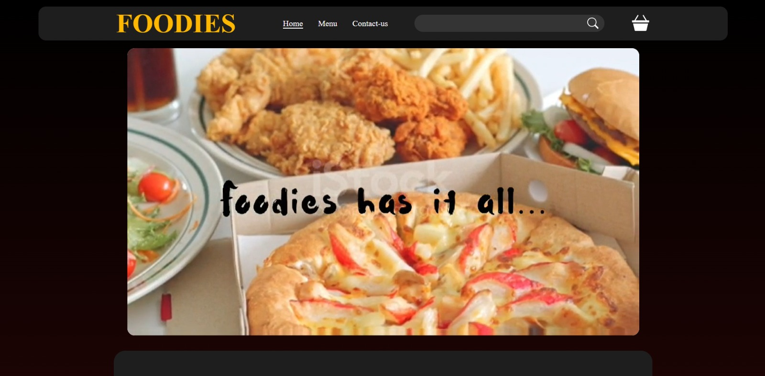
OUTPUT OF OUR CODE:

Slide 10
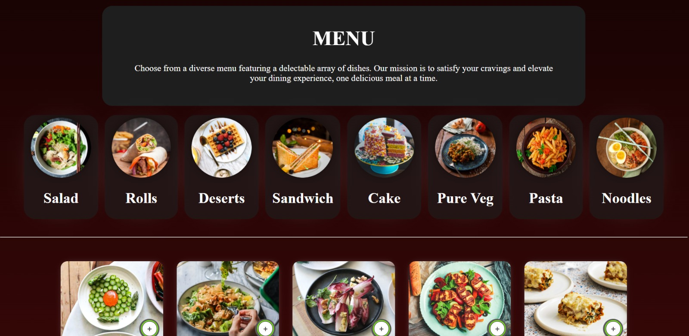

Slide 11
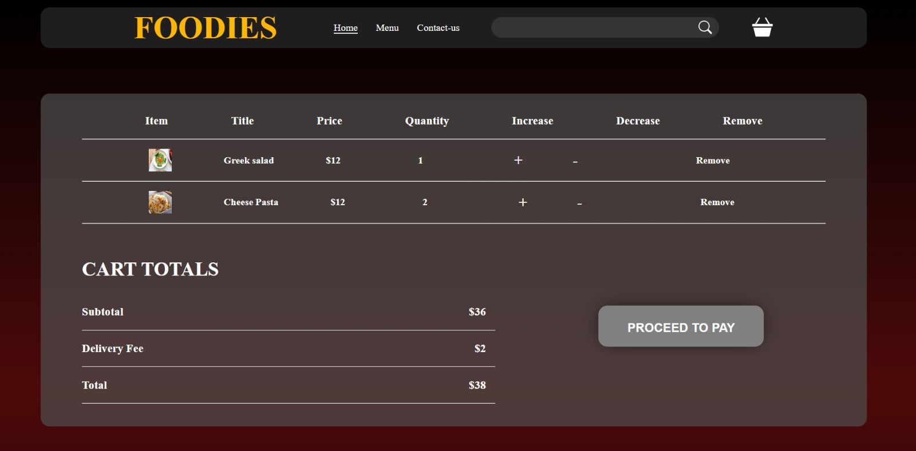

Slide 12
CONCLUSION:
In conclusion, the Food Web project has successfully achieved its goal of providing users with a seamless and enjoyable platform for exploring and discovering culinary delights. By implementing key features such as dynamic food cards, an interactive search bar, a responsive navigation menu, and a user-friendly interface, we have created an intuitive and immersive experience for users. With these features in place, users can effortlessly browse through a diverse selection of food options, find inspiration for their next meal, and engage with the platform in a way that meets their unique preferences and needs. Moving forward, we remain committed to further enhancing the Food Web application, ensuring that it continues to delight and satisfy users with its rich culinary content and intuitive design.

Slide 13
REFERENCES:
References of this project have been taken from the below mentioned sites:
https://www.w3schools.com/
https://www.youtube.com/
https://www.geeksforgeeks.org/
https://www.tutorialspoint.com/
https://en.wikipedia.org/wiki/

Slide 14


